Slide 1
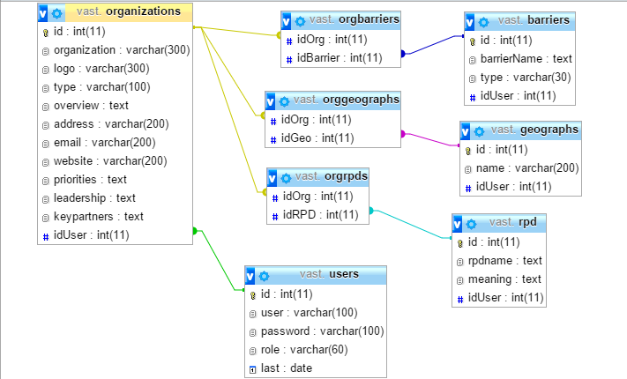

MySQL Relations and Design
Table Relationships and Joins, Transactions
SoftUni Team
Technical Trainers
Software University
http://softuni.bg

Slide 2
Table of Contents
Aggregate Functions
Table Relationships
Joins
Using MySQL and PHP
Transactions

Slide 3
Have a Question?
sli.do #php-web

Slide 4


Aggregate Functions
COUNT, SUM, MAX, MIN, AVG…

Slide 5
COUNT
COUNT - counts the values (not nulls) in one or more columns based on grouping criteria
employee | department_name | salary
Adam | Database Support | 5,000
John | Database Support | 15,000
Jane | Application Support | 10,000
George | Application Support | 15,000
Lila | Application Support | 5,000
Fred | Software Support | 15,000
department_name | SalaryCount
Database Support | 2
Application Support | 3
Software Support | 1
Notes:
If any of the values are NULL they are ignored. For example, if one the values is NULL and the other is 5,000 the COUNT will return 1 because it will ignore the NULL value. On the other hand, we can count everything by writing COUNT(*).

Slide 6
COUNT Syntax
Note that we when we use COUNT we will ignore any employee with NULL salary.
Grouping Column
New Column Alias
SELECT e.`department_id`,
COUNT(e.`salary`) AS 'Salary Count'
FROM `employees` AS e
GROUP BY e.`department_id`;
Grouping Columns

Slide 7
SUM
SUM - sums the values in a column
employee | department_name | salary
Adam | Database Support | 5,000
John | Database Support | 15,000
Jane | Application Support | 10,000
George | Application Support | 15,000
Lila | Application Support | 5,000
Fred | Software Support | 15,000
department_name | total_salary
Database Support | 20,000
Application Support | 30,000
Software Support | 15,000

Slide 8
SUM Syntax
If any department has no salaries NULL will be displayed.
Grouping Column
New Column Alias
SELECT e.`department_id`, SUM(e.`salary`) AS 'TotalSalary'
FROM `employees` AS e
GROUP BY e.`department_id`;
Table Alias
Grouping Columns

Slide 9
MAX
MAX - takes the maximum value in a column.
employee | department_name | salary
Adam | Database Support | 5,000
John | Database Support | 15,000
Jane | Application Support | 10,000
George | Application Support | 15,000
Lila | Application Support | 5,000
Fred | Software Support | 15,000
department_name | max_salary
Database Support | 20,000
Application Support | 30,000
Software Support | 15,000
Notes:
NULLs are ignored again.

Slide 10
MAX Syntax
Grouping Column
SELECT e.`department_id`, MAX(e.`salary`) AS 'MaxSalary'
FROM `employees` AS e
GROUP BY e.`department_id`;
New Column Alias
Table Alias
Grouping Columns

Slide 11
MIN
MIN takes the minimum value in a column.
employee | department_name | salary
Adam | Database Support | 5,000
John | Database Support | 15,000
Jane | Application Support | 10,000
George | Application Support | 15,000
Lila | Application Support | 5,000
Fred | Software Support | 15,000
department_name | min_salary
Database Support | 5,000
Application Support | 5,000
Software Support | 15,000

Slide 12
MIN Syntax
Grouping Column
SELECT e.`department_id`, MIN(e.`salary`) AS 'MinSalary'
FROM `employees` AS e
GROUP BY e.`department_id`;
New Column Alias
Table Alias
Grouping Columns

Slide 13
AVG
AVG calculates the average value in a column.
employee | department_name | salary
Adam | Database Support | 5,000
John | Database Support | 15,000
Jane | Application Support | 10,000
George | Application Support | 15,000
Lila | Application Support | 5,000
Fred | Software Support | 15,000
department_name | average_salary
Database Support | 10,000
Application Support | 10,000
Software Support | 15,000

Slide 14
Demo: AVG Syntax
Grouping Column
New Column Alias
SELECT e.`department_id`,
AVG(e.`salary`) AS 'AvgSalary'
FROM `employees` AS e
GROUP BY e.`department_id`;
Table Alias
Grouping Columns

Slide 15
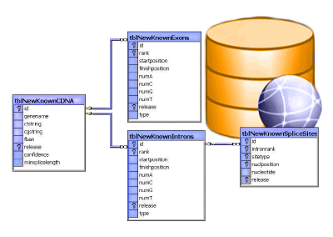
Table Relationships

Slide 16
Why Split Related Data?
Empty records
First | Last | Registered | Email
David | Rivers | 05/02/2016 | drivers@mail.cx
Sarah | Thorne | 07/17/2016 | sarah@mail.cx
Michael | Walters | 11/23/2015 | walters_michael@mail.cx
Email2
david@homedomain.cx
NULL
NULL
Redundant information
OrderID | Date | Customer | Product | S/N | Price
00315 | 07/16/2016 | David Rivers | Oil Pump | OP147-0623 | 69.90
00315 | 07/16/2016 | David Rivers | Accessory Belt | AB544-1648 | 149.99
00316 | 07/17/2016 | Sarah Thorne | Wiper Fluid | WF000-0001 | 99.90
00317 | 07/18/2016 | Michael Walters | Oil Pump | OP147-0623 | 69.90

Slide 17
Related Tables
We split the data and introduce relationships between the tables to avoid repeating information
The connection is established via a Foreign Key in one table pointing to the Primary Key in another
UserID | First | Last | Registered
203 | David | Rivers | 05/02/2016
204 | Sarah | Thorne | 07/17/2016
205 | Michael | Walters | 11/23/2015
UserID | Email
203 | drivers@mail.cx
204 | sarah@mail.cx
205 | walters_michael@mail.cx
203 | david@homedomain.cx
Primary Key
Foreign Key

Slide 18
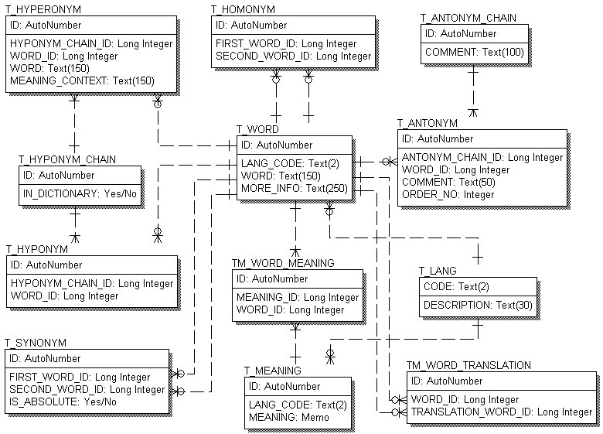
E/R Diagrams

Slide 19
Relationships
There are 3 types of relationships in relational database design. They are:
One-to-One
One-to-Many (or Many-to-One)
Many-to-Many

Slide 20
Relationships (2)
Relationships between tables are based on interconnections: PRIMARY KEY / FOREIGN KEY
Primary key
Foreign key
Primary key
towns
countries
id | name | country_id
1 | Sofia | 1
2 | Varna | 1
3 | Munich | 2
4 | Berlin | 2
5 | Moscow | 3
id | name
1 | Bulgaria
2 | Germany
3 | Russia
Relationships

Slide 21
One-to-Many/Many-to-One
Primary key
Primary key
Foreign key
Mountains
Peaks
mountain_id | name
1 | Causasus
peak_id | mountain_id
61 | 1
66 | 1
Relation
Notes:
One-to-Many relationship means that each row from a table is related zero, one or many rows in the referent table. In the case above, each mountain can have 0, 1 or many peaks. The example shows that the mountain Caucasus has two peaks - One-to-Many. If you look the other way around many peaks has exactly one mountain – Many-to-One.

Slide 22
Setup
CREATE TABLE mountains(
mountain_id INT PRIMARY KEY,
mountain_name VARCHAR(50)
);
CREATE TABLE peaks (
peak_id INT PRIMARY KEY,
mountain_id INT,
CONSTRAINT fk_peaks_mountains
FOREIGN KEY (mountain_id) REFERENCES mountains(mountain_id) );
Primary key
Table Peaks
Foreign Key

Slide 23
Foreign Key
Constraint Name
CONSTRAINT fk_peaks_mountains FOREIGN KEY (mountain_id) REFERENCES mountains(mountain_id);
Foreign Key
Referent Table
Primary Key

Slide 24
Many-to-Many
Primary key
Primary key
employees
projects
employee_id | name
1 | …
40 | …
project_id | name
4 | …
24 | …
Mapping table
employees_projects
employee_id | project_id
1 | 4
40 | 24
Notes:
Many-to-Many relationship relates many rows from a table to many rows in another table. For example. Employee.EmployeeID has many projects. Many projects are assigned to many employees which is the other way around. Usually we have a mapping table that takes care of the relations.

Slide 25
Setup(1)
CREATE TABLE employees (
employee_id INT PRIMARY KEY, employee_name VARCHAR(50)
);
Table Employees
CREATE TABLE projects ( project_id INT PRIMARY KEY, project_name VARCHAR(50)
);
Table Projects

Slide 26
Setup(2)
CREATE TABLE employees_projects( employee_id INT, project_id INT,
CONSTRAINT pk_employees_projects
PRIMARY KEY(employee_id, project_id),
CONSTRAINT fk_employees_projects_employees
FOREIGN KEY(employee_id)
REFERENCES employees(employee_id),
CONSTRAINT fk_employees_projects_projects
FOREIGN KEY(project_id)
REFERENCES projects(project_id)
);
Mapping Table
Primary Key
Foreign Key
Foreign Key

Slide 27
One-to-One
Primary key
Primary key
Foreign key
cars
drivers
car_id | driver_id
1 | 166
2 | 102
driver_id | driver_name
166 | …
102 | …
Relation
Notes:
In One-to-One relationship each row of table Cars is related to exactly zero or one row in table Drivers. In table Cars.DriverID is a foreign key which means that there will be a relation to another table – Drivers in the case. Table Drivers has a column DriverID as well which is a primary key. The relation is always between a foreign key and a primary key. It means that all values in Cars.DriverID should be present in Drivers. DriverID except NULL. Cars.DriverID can be NULL if it is not stated otherwise.

Slide 28
Setup
CREATE TABLE drivers(
driver_id INT PRIMARY KEY,
driver_name VARCHAR(50)
);
CREATE TABLE cars(
car_id INT PRIMARY KEY,
driver_id INT UNIQUE,
CONSTRAINT fk_cars_drivers FOREIGN KEY (driver_id) REFERENCES drivers(driver_id)
);
Primary key
One driver
per car
Foreign Key

Slide 29
Foreign Key
Constraint Name
CONSTRAINT fk_cars_drivers FOREIGN KEY (driver_id) REFERENCES drivers(driver_id)
Foreign Key
Primary Key
Referent Table

Slide 30

JOINS
Gathering Data From Multiple Tables

Slide 31
Data from Multiple Tables
Sometimes you need data from several tables:
Employees
Departments
employee_name | department_id
Edward | 3
John | NULL
department_id | department_name
3 | Sales
4 | Marketing
5 | Purchasing
employee_name | department_id | department_name
Edward | 3 | Sales
Notes:
Data from Multiple Tables
Sometimes you need to use data from more than one table. In the slide example, the report displays data from two separate tables.
To produce the report, you need to link (join) the Employees and Departments tables and access data from both of them.

Slide 32
Types of Joins
At the top level there are mainly 3 types of joins:
INNER
OUTER
CROSS
INNER JOIN - fetches data if present in both the tables.
OUTER JOIN are of 3 types:
LEFT OUTER JOIN - fetches data if present in the left table.
RIGHT OUTER JOIN - fetches data if present in the right table.
FULL OUTER JOIN - fetches data if present in either of the two tables.
CROSS JOIN, as the name suggests, does [n X m] that joins everything to everything.
Notes:
These are SQL99 compliant joins

Slide 33
Inner Join
Employees
Departments
employee_id | department_id
263 | 3
270 | NULL
department_id | department_name
3 | Sales
4 | Marketing
5 | Purchasing
Result
employee_id | department_id | department_id | department_name
263 | 3 | 3 | Sales
Notes:
Inner joins return only rows which exist in both tables.

Slide 34
Inner Join Syntax
Table Employees
SELECT * FROM employees AS e
INNER JOIN departments AS d
ON e.department_id = d.department_id;
Table Depatments
Inner Join
Join Conditions

Slide 35
Left Outer Join
Employees
Departments
employee_id | department_id
263 | 3
270 | NULL
department_id | department_name
3 | Sales
4 | Marketing
5 | Purchasing
X
Result
employee_id | department_id | department_id | department_name
263 | 3 | 3 | Sales
270 | NULL | NULL | NULL
Notes:
Left outer joins return all the data in the first(left) table and all the data from the second(right) table that matches the join conditions. If the data in the right table doesn’t match any data in the left table the return value is NULL.

Slide 36
Left Outer Join Syntax
Table Employees
SELECT * FROM employees AS e
LEFT OUTER JOIN departments AS d
ON e.department_id = d.department_id;
Table Depatments
Left Join
Join Conditions

Slide 37
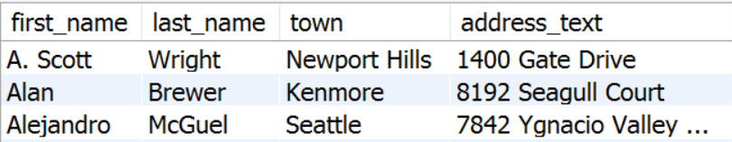

Problem: Addresses with Towns
Display address information of all employees in "SoftUni" database. Select first 5 employees.
The exact format of data is shown below.
Order them by first_name, then by last_name (ascending).
Hint: Use three-way join.
Notes:
Three-Way Joins
A three-way join is a join of three tables. In SQL: 1999 compliant syntax, joins are performed from left to right so the first join to be performed is Employees JOIN ADDRESS. The first join condition can reference columns in Employees and ADDRESS but cannot reference columns in STATEPROVINCE. The second join condition can reference columns from all three tables.
This can also be written as a three-way equijoin:
SELECT e.LastName, a.City, sp.Name SPName
FROM employee e, address a, stateprovince sp
WHERE e.AddressID = a.AddressID
AND a.StateProvinceID = sp.StateProvinceID

Slide 38
Solution: Addresses with Towns
Cross Table Selection
SELECT e.first_name, e.last_name,
t.name as town, a.address_text
FROM employees AS e
JOIN addresses AS a ON e.address_id = a.address_id
JOIN towns AS t ON a.town_id = t.town_id
ORDER BY e.first_name, e.last_name LIMIT 5;
Table Employees
Table Towns
Notes:
Three-Way Joins
A three-way join is a join of three tables. In SQL: 1999 compliant syntax, joins are performed from left to right so the first join to be performed is Employees JOIN ADDRESS. The first join condition can reference columns in Employees and ADDRESS but cannot reference columns in STATEPROVINCE. The second join condition can reference columns from all three tables.
This can also be written as a three-way equijoin:
SELECT e.LastName, a.City, sp.Name SPName
FROM employee e, address a, stateprovince sp
WHERE e.AddressID = a.AddressID
AND a.StateProvinceID = sp.StateProvinceID

Slide 39
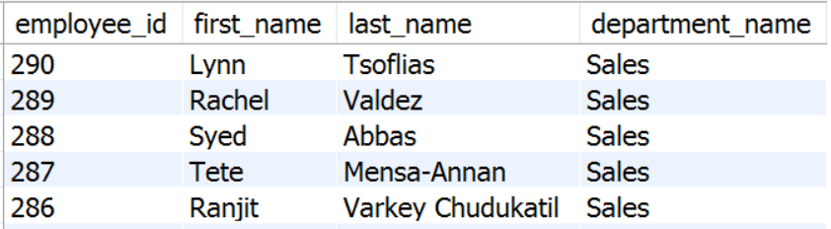
Problem: Sales Employees
Find all employees that are in the "Sales" department. Use "SoftUni" database.
Follow the specified format:
Order them by employee_id DESC.
Notes:
The example shown performs a join on the Employees and Departments tables, and, in addition, displays only employees within the Sales department.

Slide 40
Solution: Sales Employees
Cross Table Selection
SELECT e.employee_id, e.first_name, e.last_name,
d.name AS department_name
FROM employees AS e
INNER JOIN departments AS d
ON e.department_id = d.department_id
WHERE d.name = 'Sales'
ORDER BY e.employee_id DESC;
Table Departments
WHERE Predicate
Notes:
The example shown performs a join on the Employees and Departments tables, and, in addition, displays only employees within the Sales department.

Slide 41


Problem: Countries without any Mountains
Display the count of all countries which don’t have a mountain
Use Geography Database

Slide 42
Solution: Countries without any Mountains
SELECT
COUNT(*) AS country_count
FROM
countries AS c
LEFT JOIN mountains_countries AS mc
ON c.country_code = mc.country_code
WHERE mc.mountain_id IS NULL;

Slide 43


Accessing MySQL from PHP
Using mysqli

Slide 44
Using MySQL in PHP: Connect & Query
Use mysqli class to connect to MySQL from PHP script
Execute a SQL query through existing MySQL connection
$mysqli =
new mysqli('localhost', 'root', '', 'blog');
$mysqli->set_charset("utf8");
if ($mysqli->connect_errno) die('Cannot connect to MySQL');
$result = $mysqli->query('SELECT * FROM posts');
if (!$result)
die('Cannot read `posts` table');

Slide 45
Using MySQL in PHP: Fetch Records
Process the returned result set (table rows / records)
$result =
$mysqli->query('SELECT * FROM posts');
while ($row = $result->fetch_assoc()) {
$title = $row['title'];
// TODO: print the title
$content = $row['content'];
// TODO: print the content
}

Slide 46
Using MySQL in PHP: Prepared Statement
Using a prepared statement with parameters
function deletePost($mysqli, $id) {
$statement = $mysqli->prepare(
"DELETE FROM posts WHERE id = ?");
$statement->bind_param("i", $id);
$statement->execute();
return $statement->affected_rows > 0;
}
Param types: s – string i – integer d – double

Slide 47
Accessing MySQL from PHP
Using PDO

Slide 48
Connect and Process Query
We will use the PDO extension
try {
$db = new PDO('mysql:host=localhost;dbname=softuni', $user, $pass);
$result = $db->query('SELECT * FROM Users', PDO::FETCH_ASSOC);
foreach ($result as $row) {
print_r($row);
}
$result = null;
$db = null;
} catch (PDOException $e) {
print "Error!: " . $e->getMessage() . "<br/>";
}
query method does not escape data
Close the connection
Default on error is exception

Slide 49
Using Prepared Statement (SELECT)
try {
$db = new PDO('mysql:host=localhost;dbname=softuni', $user, $pass);
$stmt = $db->prepare("SELECT * FROM Users WHERE fname = ?");
if ($stmt->execute(array($_GET['fname']))) {
while ($row = $stmt->fetch(PDO::FETCH_ASSOC)) {
print_r($row);
}
}
$stmt = null;
$db = null;
} catch (PDOException $e) {
print "Error!: " . $e->getMessage() . "<br/>";
}
Placeholder to replace later in execute method
Close the connection
Automatic escaping by the driver

Slide 50
Using Prepared Statement (INSERT)
try {
$stmt = $db->prepare("INSERT INTO Users (fname, lname) VALUES (?, ?)");
$stmt->bindParam(1, $fname);
$stmt->bindParam(2, $lname);
$fname = 'Joro';
$lname = 'Petrov';
$stmt->execute();
$fname = 'Vasil';
$lname = 'Georgiev';
$stmt->execute();
} catch (PDOException $e) {
print "Error!: " . $e->getMessage() . "<br/>"; }
Init connection
We can bind variables to parameters
Never forget to close the connection

Slide 51

Transactions
Following the ACID properties

Slide 52
Running Transactions
A transaction is a sequence of operations performed as a single logical unit of work
Mark start of transaction
START TRANSACTION
INSERT INTO Projects(Name, StartDate)
VALUES('Introduction to MySQL', '1/1/2006')
COMMIT or ROLLBACK
Confirm or cancel the changes

Slide 53
ACID
Atomicity
Atomicity requires that each transaction be "all or nothing"
Consistency
The consistency property ensures that any transaction will bring the database from one valid state to another
Isolation
The isolation property ensures that the concurrent execution of transactions results
Durability
The durability property ensures that once a transaction has been committed

Slide 54
Transactions with PHP
try {
$db->beginTransaction();
$stmt = $db->prepare("INSERT INTO Users (fname, lname) VALUES (?, ?)");
$stmt->bindParam(1, $fname);
$stmt->bindParam(2, $lname);
$fname = 'Joro';
$lname = 'Petrov';
$stmt->execute();
$db->commit();
} catch (PDOException $e) {
$db->rollBack();
print "Error!: " . $e->getMessage() . "<br/>";
}
Init connection
Never forget to close the connection

Slide 55

Summary
…
…
…
Table relations reduce repetition and complexity
A SQL join is a SQL instruction to combine data from two sets of data (i.e. two tables)
Using PHP we can:
Connect and manage connection
Execute SQL Queries
With Transactions we satisfy the ACID properties

Slide 57






СофтУни диамантени партньори

Slide 58






СофтУни диамантени партньори

Slide 59





Trainings @ Software University (SoftUni)
Software University – High-Quality Education, Profession and Job for Software Developers
softuni.bg
Software University Foundation
http://softuni.foundation/
Software University @ Facebook
facebook.com/SoftwareUniversity
Software University Forums
forum.softuni.bg

